Slide 1
C_{t}
TL_{5,t}
TL_{4,t}
TL_{3,t}
ARIMA

Slide 2

TL_{z,t}
TL_{3,t}
B_{S,t+1}
T_{TL,t}
Multinomial
R_{S,t}
TL_{4,t}
$$λ$$
C_{t}
S_{1,t}
S_{2,t}
S_{3,t}
S_{4,t}
S_{5,t}

Slide 3

B_{x,t-1}
S_{x,t}
R_{x,t}
Compensatory Dynamics
$$λ$$
B_{x,t}

Slide 4
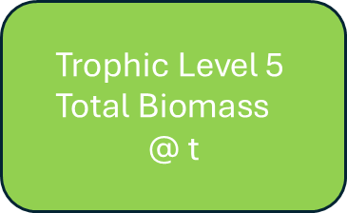
Step 1: Sum up the biomass for all stocks in trophic level 5
$$\text{Trophic} \text{Level}\text{ 5 }\text{Total} \text{Biomass}$$
$$\text{@ }\text{t}$$
B_{2,t}
B_{3,t}
B_{4,t}
B_{1,t}
B_{5,t}
Step 2: Divide this sum by the simulated trophic level resource pool (top down)
Trophic Level 5 Resource Pool
@ t
Trophic Level 4 Resource Space @ t
Trophic Level 5 Total Biomass
@ t
Step 3: Multiple the trophic level resource pool by the Resource Space
Trophic Level 4 Resource Pool
@ t
Trophic Level 4 Revised Biomass Pool @ t
Trophic Level 4 Resource Space @ t

Slide 5
C_{t}
ARIMA
S_{s,t}
TL_{3,t}
TL_{4,t}
TL_{5,t}

